Slide 1
CPRG 102: .NET Development with MVC
Module 1: Moving from Web Forms to MVC in ASP.NET

Slide 2
System Requirements (Fall 2018)
Visual Studio 2017 is essential
ASP.NET Core 2.1 (https://www.microsoft.com/net/download)
SQL Server or SQL Server Express and SS Management Studio

Slide 3
Course Schedule
Week 1
Module 1: Moving from Web Forms to MVC
Module 2: Working with MVC Controllers
Week 2
Module 3: Working with MVC Views
Module 4: Working with MVC Models (EF 6/Core)
Week 3
Module 5: HTML Helpers/Tag Helpers
Module 6: Working with Partial Views/View Components
Week 4
Module 7: Working with Bootstrap
Module 8: Javascript/JQuery/AJAX

Slide 4
Course Schedule Con’t
Week 5
Module 9: Application Security
Module 10: Web API Restful Services
Week 6
Module 11: Real Time Web Functionality (SignalR)
Module 12: Dependency Injection
Week 7
Module 13: Unit Testing
Module 14: JavaScript Frameworks (Knockout & Angular)

Slide 5
Topic 1 History of ASP.NET and
Web Forms

Slide 6
In the Beginning
“The primary goal of ASP.NET was to make it possible for developers to build applications quickly and effectively without having to deal with low-level details such as HTTP, HTML, and JavaScript intricacies.” (Esposito, 2014)

Slide 7
Rapid Application Development
Classic VB began RAD movement prior to .NET
ASP.NET continued the RAD tradition
Web Forms designed in visual environment
Server control events coded
Emulated Windows forms development
Focus was on server side processing
Web Forms very successful

Slide 8
Historical Recap
Versions 1.0 and 1.1 got us started
2.0 gave us master pages and new controls (data, navigation, login, etc.)
3.0 introduced WCF, WPF and new language features
3.5 had AJAX and new data controls
4.7 is last version with Web Forms

Slide 9
What’s Next
ASP.NET became totally open source
ASP.NET Core completely rewritten from the ground up (not just a newer version)
Applications able to run on Windows, Linux and OSX
Web Forms not supported in ASP.NET Core
Public release 2016

Slide 10
Topic 2 Pros and Cons of Web Forms

Slide 11
Advantages
RAD environment = more productivity
Rich server controls = less coding
Easy to learn = less reliance on HTML, CSS and JavaScript
Event driven programming = easy to code
Easy transition from Windows development to web = familiarity

Slide 12
Limitations
ViewState can cause performance issues
HTML markup page and code behind file are tightly coupled
Limited control over HTML, CSS and JavaScript
Unit testing is very difficult

Slide 13
Topic 3 Overview of MVC Pattern

Slide 14
The Oldest Pattern
MVC has been around since the ’80s
Divides the software application into three distinct component roles
Model – the business logic and data access layers
The View – the presentation layer (User Interfaces)
The Controller – handles user interaction and manipulates the model

Slide 15
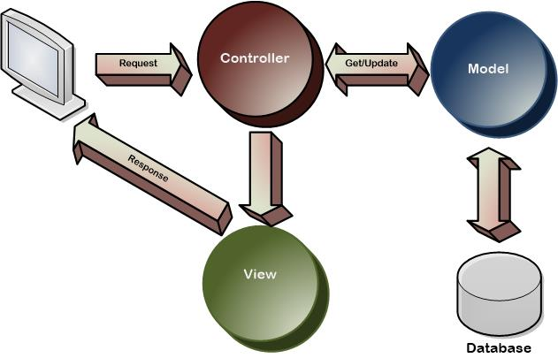
MVC Pattern

Slide 16
Versions
ASP.NET MVC 1.0 released March 2009
ASP.NET MVC 2.0 released March 2010
ASP.NET MVC 3.0 released January 2011
ASP.NET MVC 4.0 released August 2012
ASP.NET MVC 5.0 released October 2013
This was the last version of ASP.NET MVC before a new MVC framework called MVC Core was released in 2016

Slide 17
ASP.NET Core Versions
Version 1.0 released June, 2016
Version 1.1 released November, 2016
Version 2.0 released August, 2017
Version 2.1 released May, 2018
ASP.NET Core 2.0, 2.1 and 2.2 will only run on
Visual Studio 2017

Slide 18
Advantages
No ViewState = better performance
No server controls
More control over HTML, JavaScript and CSS
Separation of concerns
Unit testing easier
Convention over configuration

Slide 19
Challenges
Higher learning curve than Web Forms
No server side controls offered
Project files/hierarchy can be complex
Requires increased knowledge of HTML, JavaScript and CSS
Knowledge of other JavaScript frameworks

Slide 20
MVC vs MVP vs MVVM
Similar in concept—all have Models and Views
MVC has Controller
Controller actions called by view events
MVP has Presenter
Presenter instantiated by the View
An interface decouples the View and Presenter
The presenter handles UI events on behalf of the View
MVVM has ViewModel
Two-way data-binding communicates state change
Implements Observer pattern

Slide 21
Topic 4 What’s New in ASP.NET

Slide 22
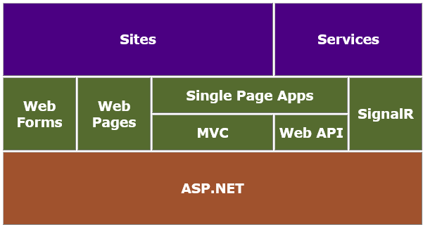
ASP.NET Technology Stack

Slide 23
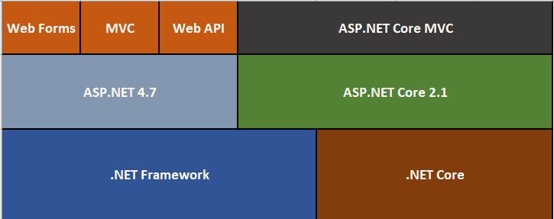
The New ASP.NET Stack

Slide 24
ASP.NET Core Improvements
Supports cross-platform development
Small .NET Core
Host on IIS or self-host
New HTTP request pipeline
Ships entirely as NuGet packages
Dependency Injection support is built in
New open source tooling available
MVC and Web API now a single stack
Web Forms revert to version 4.6/4.7
Cloud-ready environment-based configuration

Slide 25
New .NET Execution Environments
.NET Core 1.0
DNX is an SDK and runtime environment hosts CLR
Built for running cross-platform ASP.NET applications
Makes it easy to create and consume packages
Open source friendly
.NET Core 2.0
CLI – Command Line Interface is new runtime
Can install side by side with other versions of .NET Core
Basic commands include new, build, publish, run, etc
dotnet new console –n TestConsole
cd TestConsole
dotnet run

Slide 26
The Startup Class
The class defines ASP.NET Core applications and has four main members:
Configuration property loads app settings and environment variables
The constructor specifies how the application will handle configuration
ConfigureServices method defines which services used by the application
Configure method defines the middleware that makes up the request pipeline

Slide 27
New Configuration Framework
No machine.config or web.config used by the DNX
System.Configuration replaced
Extensive use of JSON files for configuration
Highly extensible
XML, JSON and INI all supported

Slide 28
New Services Concept
Any component intended for common consumption in the application
Services are made available through dependency injection
Services fall into one of three categories
Singleton services only created once
Scoped services created for each request
Transient services created as requested from the container

Slide 29
New Middleware Concept
Composes the request pipeline
Performs asynchronous logic on an HttpContext
Prebuilt middleware includes:
Routing
Diagnostics
Authentication

Slide 30
Open Web Interface for .NET
OWIN supported by ASP.NET Core
Allows web applications to be decoupled from web servers
OWIN support added as a packaged dependency in a JSON file
Leverage WebSockets support

Slide 31
Client-Side Development
ASP.NET Core designed for seamless integration with many client-side frameworks
AngularJS – build single-page applications (SPA)
KnockoutJS – a client-side binding framework
Bootstrap – build responsive websites
Bower – manage client-side packages

Slide 32
Moving from MVC 5 to MVC Core
ASP.NET Core changed everything
From HTML Helpers to Tag Helpers
MVC and Web API merged into one project type
View Components similar to partial views

Slide 33
Topic 5 The Convention of
MVC Projects

Slide 34
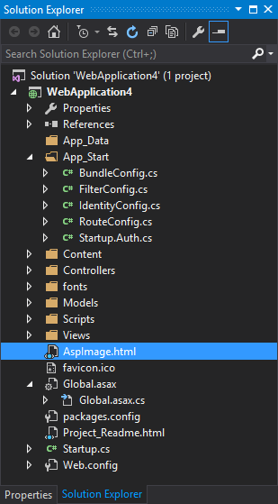
MVC 5 Project Structure
Config files used for project configuration
Folder for controllers
Folder for views
Folder for javascript and jquery scripts
Folder for CSS files (Content)

Slide 35
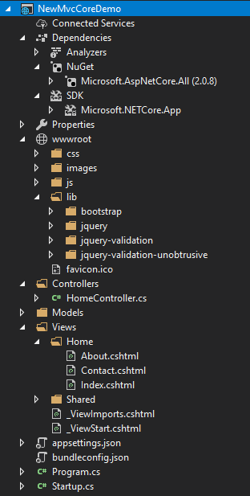
MVC Core Project Structure
JSON files used for project configuration
Folder for controllers
Folder for views
New wwwroot contains site files (CSS, images, javascript and library files)
Naming conventions
HomeController
Home views managed by the Home controller

Slide 36
Demonstrations
In the demonstrations for this module, you will see MVC 5 and MVC Core solutions for the sake of comparison
We will be introduced to some of the changes brought forward in ASP.NET Core
We will learn how to start a new application using an empty project template
We will learn how to start a project using a standard starter project template

Slide 37
References
Esposito, D. (2014). Programming Microsoft ASP.NET MVC (3rd ed.). Sebastopol, California: O’Reilly Media.

Slide 38
© 2017, Southern Alberta Institute of Technology. All rights reserved.
This publication and materials herein are protected by applicable intellectual property laws. Unauthorized reproduction and distribution of this publication in whole or part is prohibited.
For more information, contact:
Director, Centre for Instructional Technology and Development
Southern Alberta Institute of Technology
1301 16 Ave. N.W., Calgary, AB T2M 0L4

